Slide 1
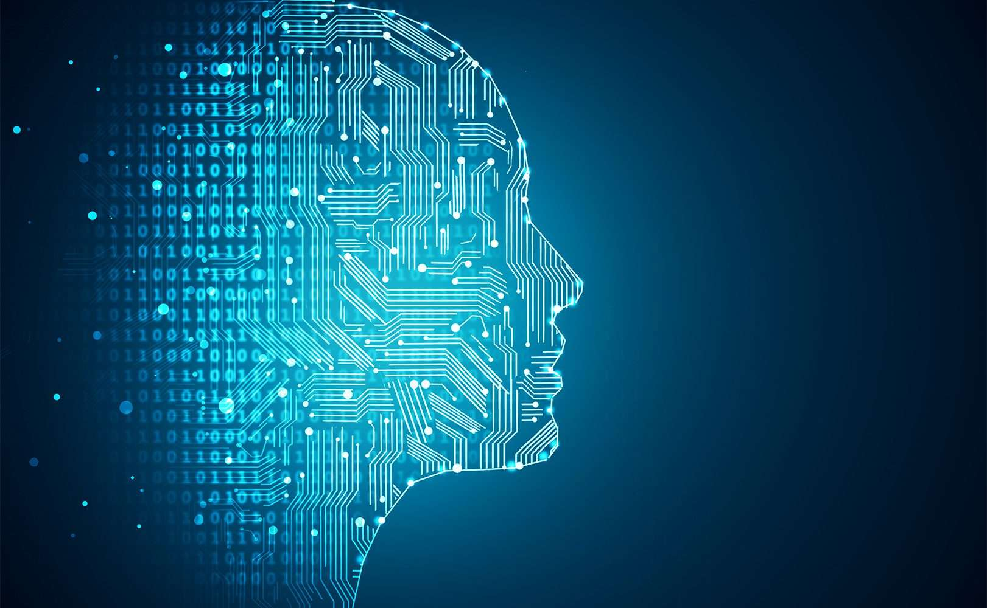
Microsoft Tech Session – Deep Learning
25 July 2018
© Copyright Bumblebee Consulting 2018

Slide 2
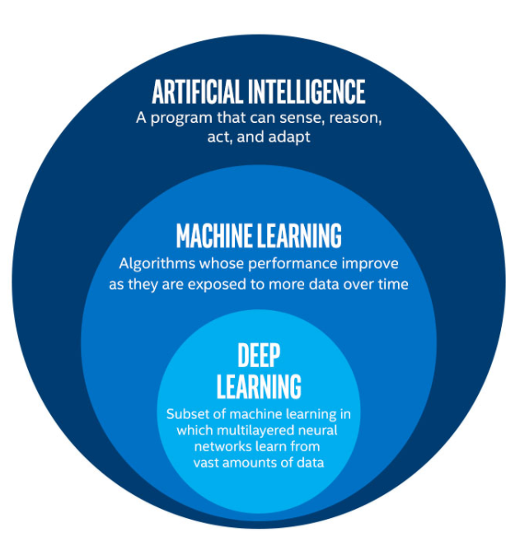
Vast Knowledge Space
© Copyright Bumblebee Consulting 2018

Slide 3
Classic Computing Model
Rules
Output
Input
© Copyright Bumblebee Consulting 2018

Slide 4
Deep Learning Computing Model
Input
Rules
Output
© Copyright Bumblebee Consulting 2018

Slide 5
Neural Networks
Modelled on the human brain
Connects neurons into layers
Start with an input layer
Connect it to hidden layers
Connect the last to an output layer
Use the output layer to predict
© Copyright Bumblebee Consulting 2018

Slide 6
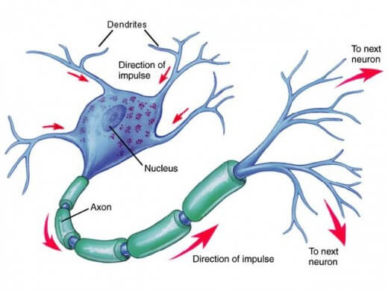
Modelled on the human brain
© Copyright Bumblebee Consulting 2018

Slide 7
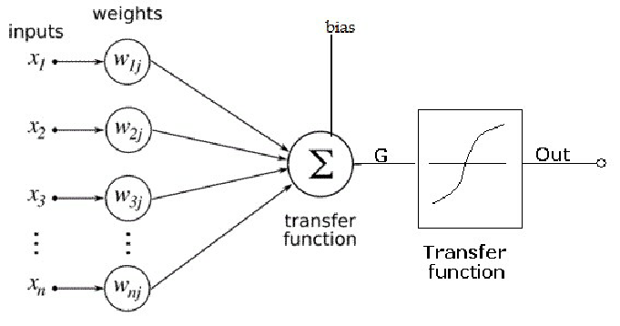
Artificial Neuron
© Copyright Bumblebee Consulting 2018

Slide 8
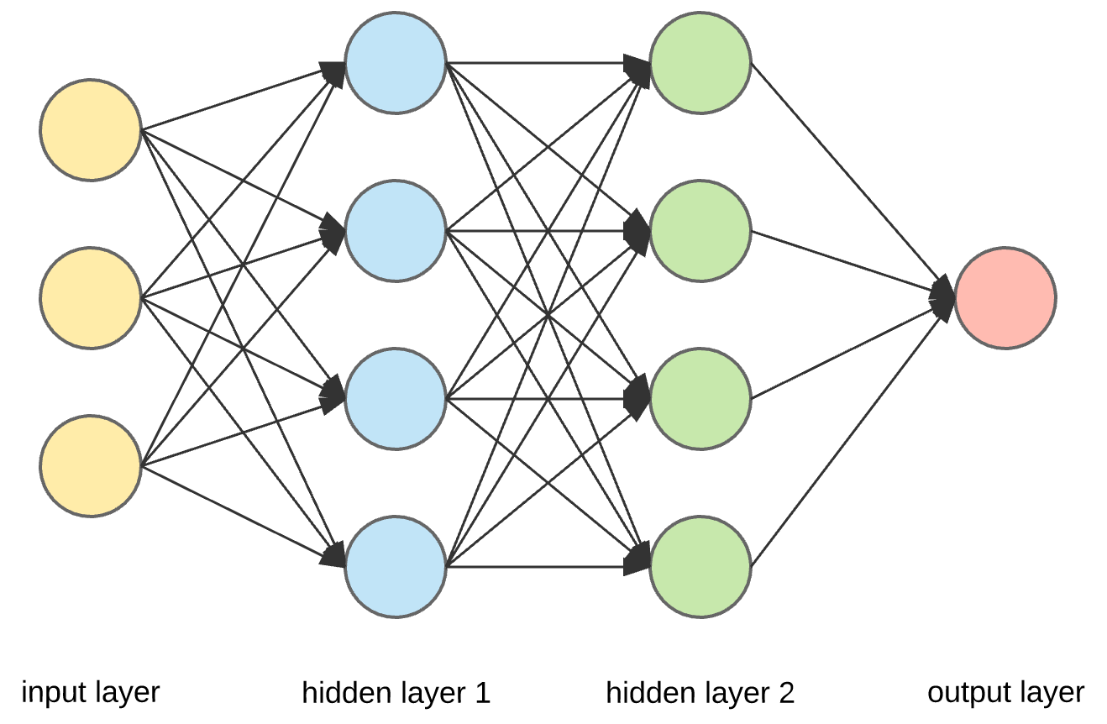
Neural Layers
© Copyright Bumblebee Consulting 2018

Slide 9
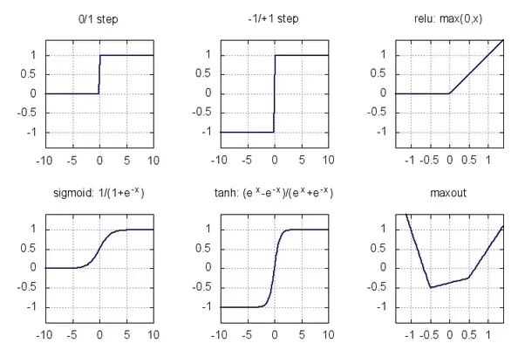
Activation Functions
© Copyright Bumblebee Consulting 2018

Slide 10
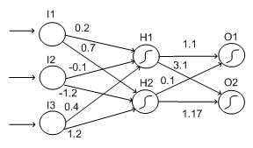
Weights make up the “brain”
© Copyright Bumblebee Consulting 2018

Slide 11
Demo
© Copyright Bumblebee Consulting 2018

Slide 12
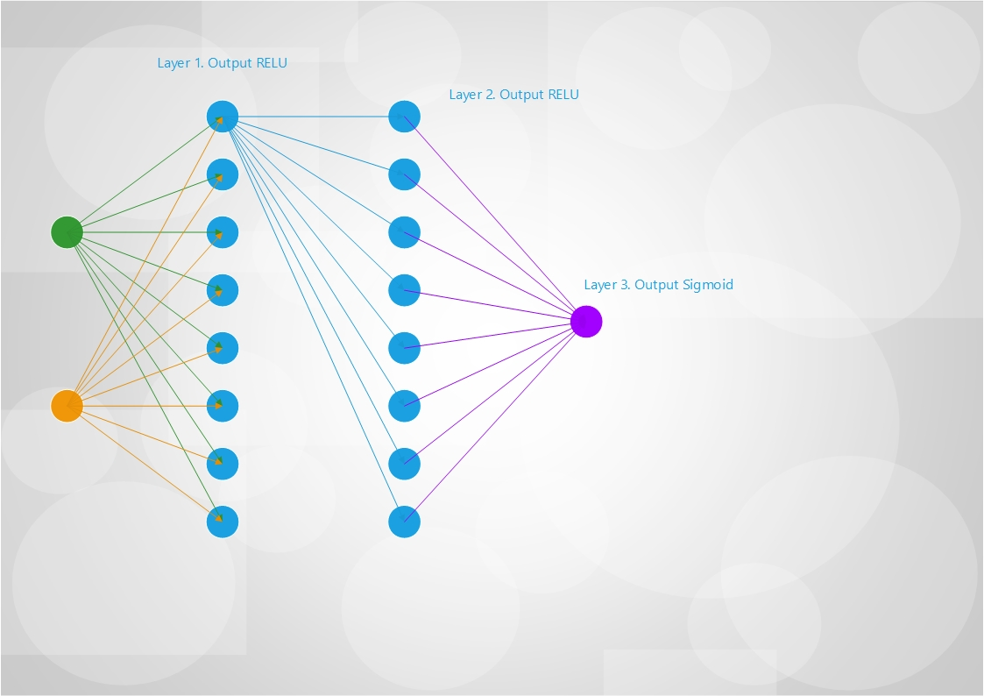
Gate Topology
© Copyright Bumblebee Consulting 2018

Slide 13
Further Reading
http://bumbee.co.za/
https://github.com/pcfour/deep-learning-presentation
© Copyright Bumblebee Consulting 2018

